Slide 1

ADVANCE DIRECTIVES
A Learning Module
for Physicians

Slide 2

Purpose
This program is intended to help physicians obtain factual information regarding advance directives to enhance patient
and family education.
Objectives
Review a brief history of advance directives
Discuss the types of advance directives used in New York State
Learn the difference between a MOLST and a Non-Hospital DNR form

Slide 3
Brief History of Advance Directives
Karen Quinlan, 1970s
  Important person in the history of the “right to die” (right to refuse extraordinary measures) controversy in the United States
  Set precedent for withdrawal of life support
  Led to development of formal Ethics Committees in institutions
Nancy Cruzan v. US Supreme Court, 1989-1990
  Supreme Court ruled it was acceptable to require "clear and convincing evidence" of a patient's wishes for removal of life support. A significant outcome of the case was the creation of advance health directives
Patient Self Determination Act, Effective December 1991
  Requires health care providers (hospitals, nursing homes, HMOs, etc) to provide information about advance directives to patients upon admission
Family Health Care Decisions Act (FHCDA), Effective June 1, 2010
  Helps identify a decision maker when the patient lacks capacity and did not leave prior instructions or appoint a health care agent
  The decision maker identified using the FHCDA is known as a Public Health Law (PHL) surrogate

Slide 4
Advance Directives
Advance directives are written instructions for health care, that indicate a person’s wishes and/or designate a trusted person in the event that they become unable to make decisions for themselves.
They are ideally prepared in advance of a health care crisis when the patient is of sound mind and is able to communicate their wishes.

Slide 5
Advance Directives cont.
Advance directives attempt to determine what medical treatment the person would choose, given the opportunity, based on diagnosis and prognosis.
They also provide an opportunity to candidly discuss the patient’s wishes with family and friends and to initiate serious discussions with their physician.

Slide 6
Advance Directives cont.
Advance directives ensure that a patient’s wishes are known regarding their own health and that they will be followed and respected even when they can no longer communicate.
Although most people equate the need for advance directives with age, it is strongly recommended that all able adults over the age of 18 discuss their wishes with their family and friends, and fill out a health care proxy accordingly.

Slide 7

Advance Directives cont.
At Crouse Hospital, if a patient has an advance directive, but does not have a copy with them on admission, the intent of the advance directive is recorded in the patient’s own words on admission. The doctor should be notified ASAP to initiate a conversation with the patient.
If the patient does have prior advance directives in their medical record history, the patient needs to be asked if they want them continued or if they want to make a change.

Slide 8
Types of Advance Directives
Advance directives differ by state
Examples of New York State advance directives are:
  Living Will:
    written document demonstrating “clear and convincing evidence” of a person’s wishes
  Health Care Proxy:
    gives a person authority to make medical decisions for an individual, it becomes active only when the individual loses capacity to make their own decisions
  MOLST:
    medical order form that details the patient’s wishes for life-sustaining treatments
  *Durable Power of Attorney*:
    relates to financial and estate planning, not used in health care decision making in NYS; other states differ
  Surrogate
    Family Health Care Decisions Act
    Relates to incapacitated adult patient
    The law only applies to patients in hospitals and nursing homes who have
lost the capacity to make medical treatment decisions and who have not
appointed an agent under a health care proxy.

Slide 9
Living Will
The living will gives specific instructions and expresses the patient’s wishes and beliefs as to the withholding or withdrawal of life-sustaining treatment (LST).
A living will does not appoint a person to make decisions in place of the incapacitated patient as with a proxy directive, but sometimes the living will and health care proxy forms are combined into one document.

Slide 10
Living Will cont.
The maker of a living will attempts to predict the health care issues that may arise in the future, and states in writing choices regarding care that should or should not be administered. It is meant to guide decision makers.
It usually addresses Life-Sustaining Treatments for patients who are:
  Terminal
  Permanently unconscious
  Not likely to regain the ability to make decisions
In New York State, a living will is “clear and convincing evidence” of a patient’s wishes, however it is not an actionable order, you still need a decision maker (HCP or PHL surrogate) to execute the order

Slide 11
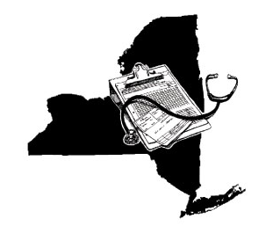
Health Care Proxy
The Health Care Proxy Law allows a person to name an individual to act on the person’s behalf to make health care decisions if the person becomes unable to make decisions for themselves
The person chosen as health care agent should be someone trusted to follow the patient’s wishes and any cultural or religious philosophies.

Slide 12

Health Care Proxy cont.
The health care agent will serve as an advocate for the patient, even if they themselves would make different decisions in a similar situation.
If a patient has multiple Health Care Proxy documents, the one with the most current date should be followed.
Only a patient can appoint and void their Health Care Proxy.

Slide 13
Medical Orders for Life-Sustaining Treatment (MOLST)
The MOLST is a physician order form used statewide that provides specific medical orders. It is intended for patients with serious health conditions who:
  Want to avoid or receive any or all life-sustaining treatment
  Reside in a long-term care facility or require long-term care
  Might die within the next year
Page 1 lists the options for DNR or CPR in the event of actual cardiac &/or respiratory arrest
Page 2 lists the other orders for life-sustaining treatment (intubation, feeding tube placement, antibiotics, etc)
MOLST is the only form authorized in NYS for documenting both DNR and DNI orders

Slide 14
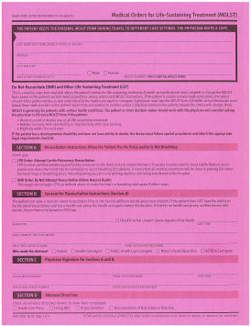
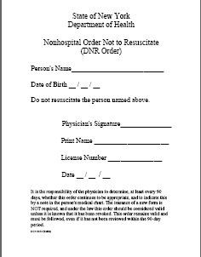
MOLST vs. Nonhospital DNR
MOLST
Nonhospital DNR
Only actionable DNI order in NYS
Lists both DNR and DNI orders
Does not indicate DNI as an option
Patients may get intubated by Emergency Services personnel if NOT yet in cardiac/respiratory arrest

Slide 15
Nonhospital Order Not to Resuscitate
(DNR Order)
Do not resuscitate (DNR) means, for a patient in cardiac and/or respiratory arrest, NO chest compressions, ventilation, defibrillation, endotracheal intubation, or ACLS medications.
If the patient is NOT in cardiac and/or respiratory arrest, full treatment for all injuries, pain, difficult or insufficient breathing, hemorrhage and/or other medical conditions must be provided.

Slide 16

DNR Orders
DNR orders can be initiated by the patient or, if the patient is unable to take part in healthcare decisions, DNR orders can be initiated by an HCP or PHL surrogate.
If the patient has no Health Care Proxy, no Public Health Law surrogate, and no family or friends that are able or willing to make decisions for the patient, 2 physicians can initiate a DNR order for the patient, only if they feel death is imminent and the patient will die with or without life-sustaining treatment.

Slide 17
DNR Orders cont.
DNR orders can be obtained as verbal consent in person or over the phone, as long as there are 2 witnesses. One of the witnesses can be the physician signing the order.
The DNR order needs to be signed by the physician within 24 hours of completion.
In the hospital, a DNR order should be reviewed every 7 days by the physician and each review should be signed and dated.
However, even if the order is not signed, the most important thing is to honor the patient’s wishes.

Slide 18

Conclusion
Health care workers must be encouraged to discuss questions and concerns regarding advance directives with their patients, who rely on them for accurate information.

